Slide 1
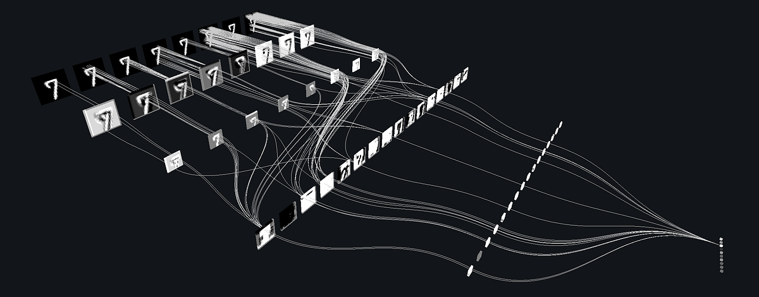
SESSION 04
WORKSHOP MARCH 2026 BY DR CORONA-LOPEZ
CONVOLUTIONAL NEURAL
NETWORKS
FACULTY OF SCIENCE AND ENGINEERING
UNIVERSITY OF MANCHESTER

Slide 2
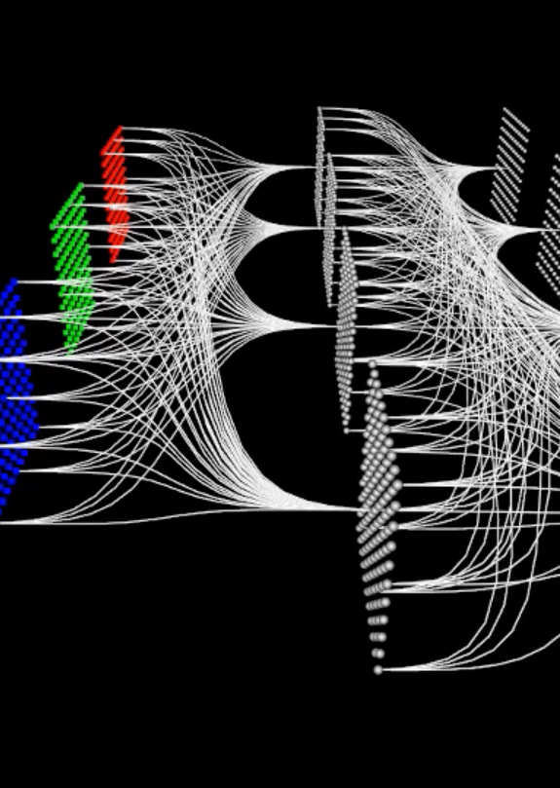
BY DR CORONA-LOPEZ
MARCH 2026
AGENDA
convolutional neural networks: why standard networks struggle with images.
the convolution operation: kernels, filters, and calculating output dimensions.
preparing image data: torchvision transforms and the historical cracks dataset.
implementing cnns: building a simple cnn and dataloaders.
evaluation: accuracy and classification reports.
advanced architectures: mobilenet.
01

Slide 3
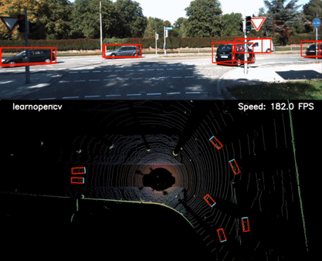
CNNs represent a monumental shift in artificial intelligence, moving beyond simple spreadsheets and audio waves to actually "seeing" and understanding visual data. unlike standard networks that process flattened lists of numbers, cnns are specifically engineered to comprehend spatial relationships, geometry, shapes, and textures within images and video. in practice, this allows cnns to perform highly complex, real-world visual tasks. they can seamlessly execute image classification to determine the main subject of a photo, perform object detection to draw precise bounding boxes around pedestrians for autonomous vehicles.
02

Slide 4
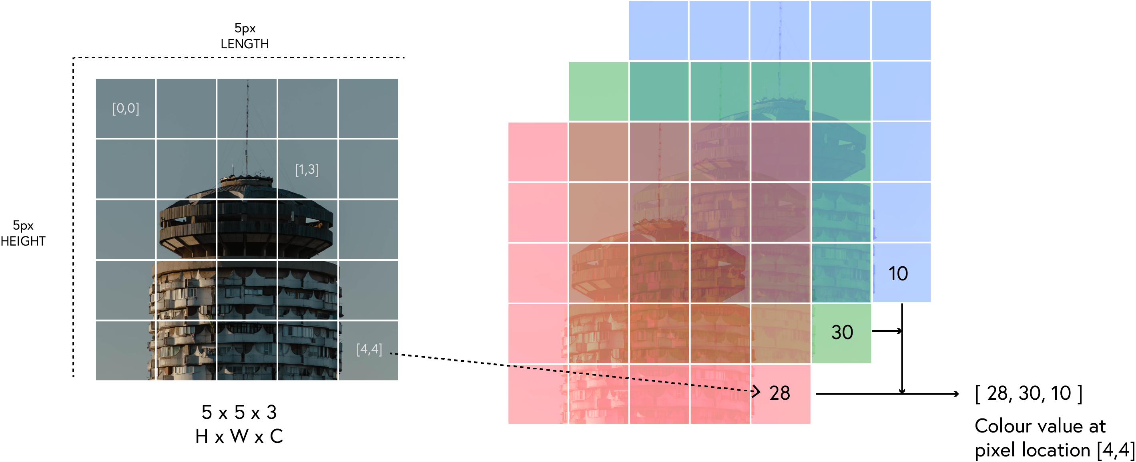
BY DR CORONA-LOPEZ
MARCH 2026
ANN STRUGGLE WITH IMAGES
spatial relationships: standard networks don't account for spatial relationships between pixels
parameter explosion: a 224×224×3 image would require over 150,000 weights per neuron
translation invariance: objects can appear anywhere in an image but have the same meaning
feature hierarchy: images contain low-level features that compose into higher-level features
03

Slide 5
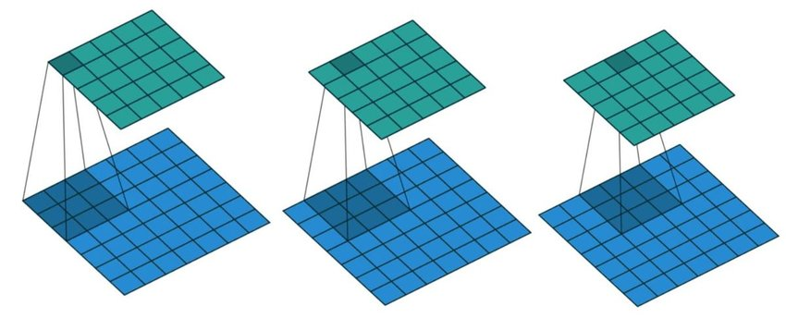
BY DR CORONA-LOPEZ
MARCH 2026
CONVOLUTION
definition: sliding a small window (kernel/filter) over an image, performing element-wise multiplication, and summing the results to create a "feature map".
04

Slide 6
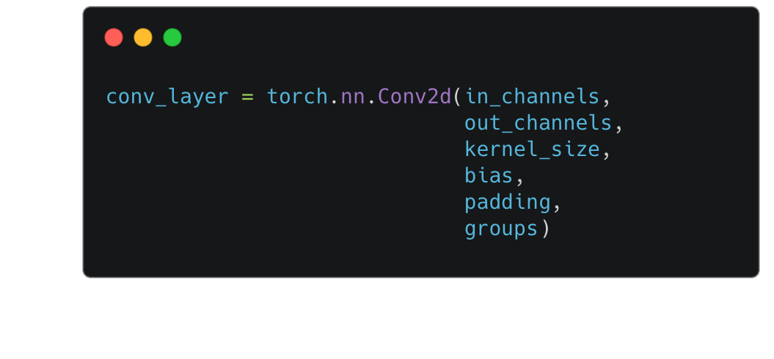

BY DR CORONA-LOPEZ
MARCH 2026
CONVOLUTION
kernel size: the dimensions of the filter
stride: how many pixels the filter shifts
padding: adding extra pixels around the border
$$Output=\frac{Input−Kernel+\left(2×Padding\right)}{Stride}+1$$
05

Slide 7
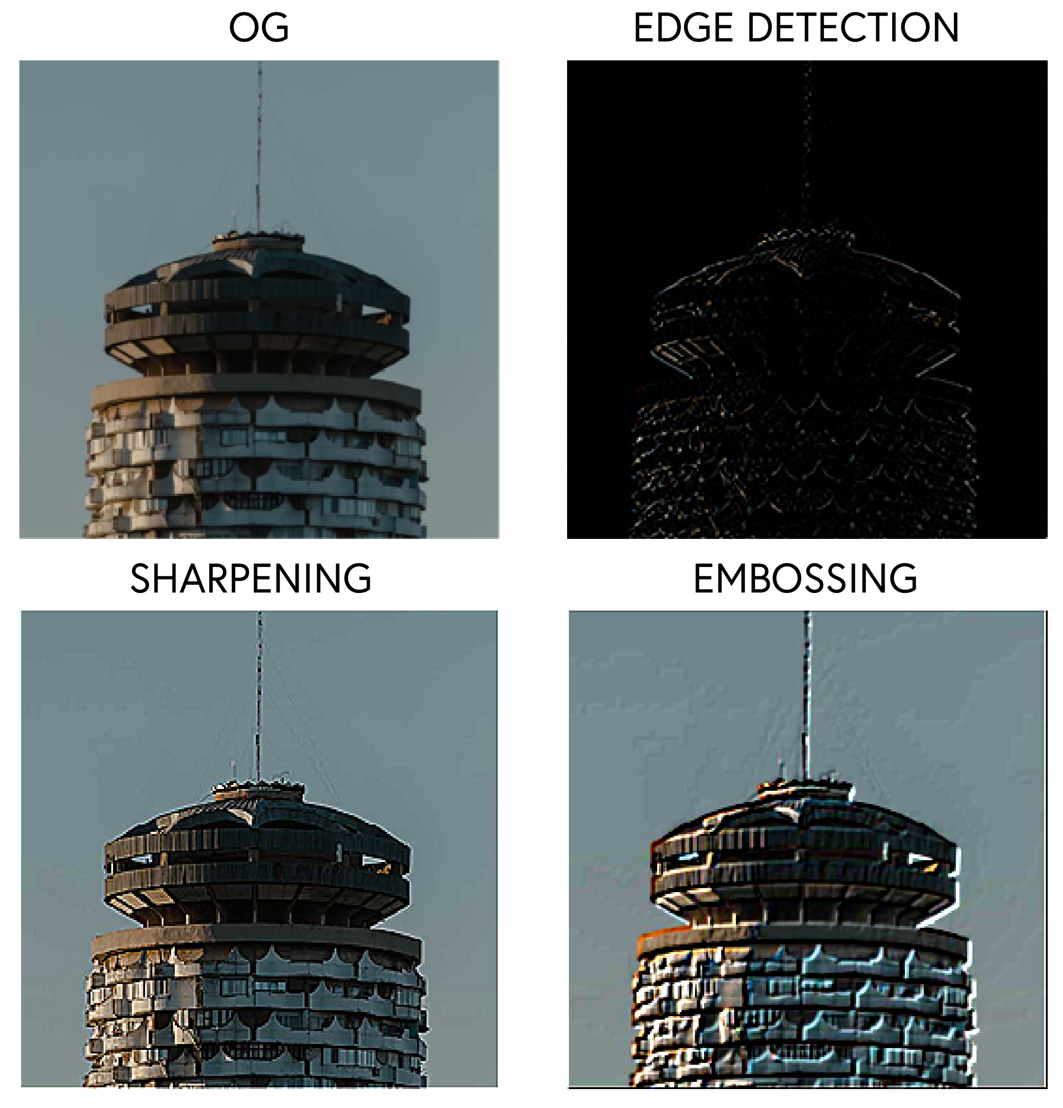
BY DR CORONA-LOPEZ
MARCH 2026
FILTERS
filters are small matrices that detect specific patterns in images
different filters detect different features:
edge detection:
[[1, 0, -1],
[1, 0, -1],
[1, 0, -1]]
sharpening:
[[ 0, -1, 0],
[-1, 5, -1],
[ 0, -1, 0]]
weights in filters are learned during training
06

Slide 8
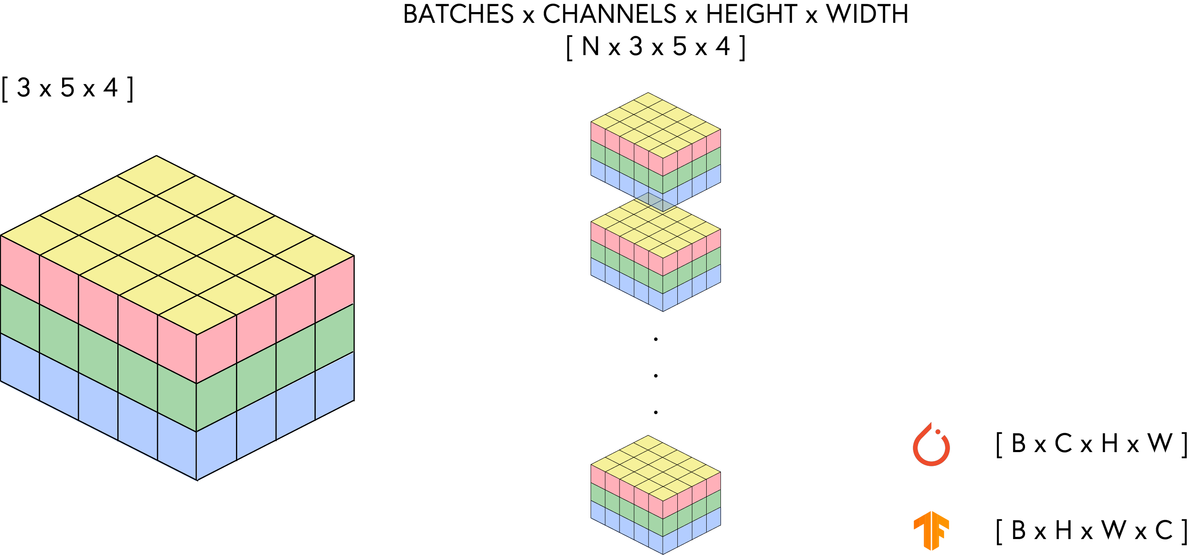
BY DR CORONA-LOPEZ
MARCH 2026
WORKING WITH IMAGES
we need to convert images into proper format for CNNs
pytorch expects 4d tensors: (batch_size, channels, height, width)
data augmentation techniques increase training set diversity
07

Slide 9
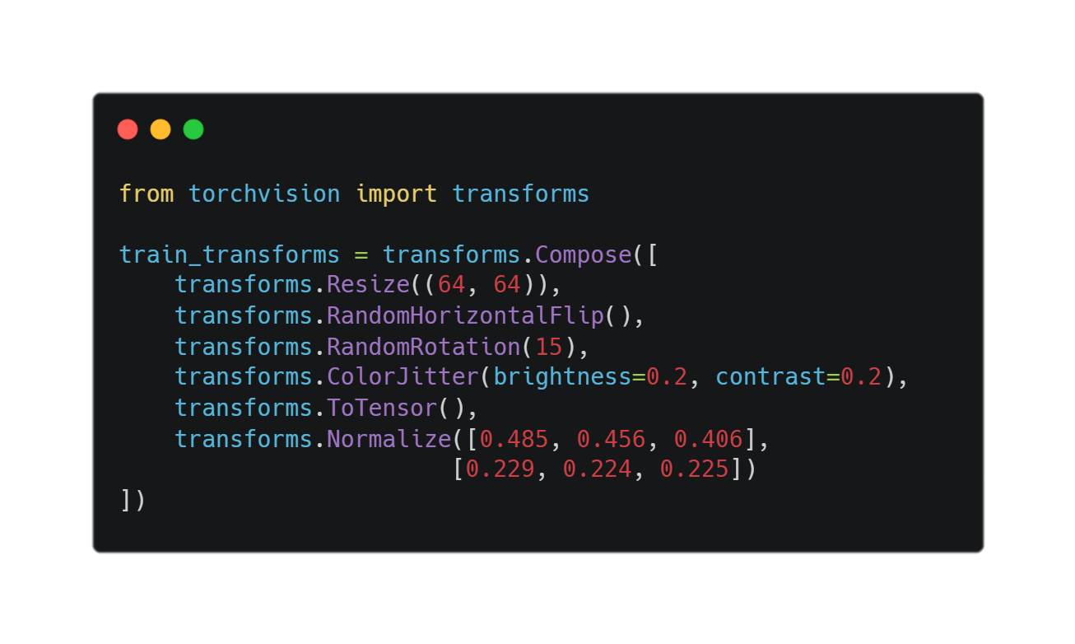
BY DR CORONA-LOPEZ
MARCH 2026
PRE-PROCESSING
torchvision.transforms is a powerful library used to preprocess images on the fly before they enter the neural network.
the pipeline -> transforms.Compose
geometric: flips, rotations, scaling, cropping
color: brightness, contrast, saturation adjustments
noise: adding random noise for robustness
occlusion: random erasing to simulate partial obscuring
combining multiple augmentations:
domain-specific augmentations (e.g., for medical images)
online vs. offline augmentation
08

Slide 10
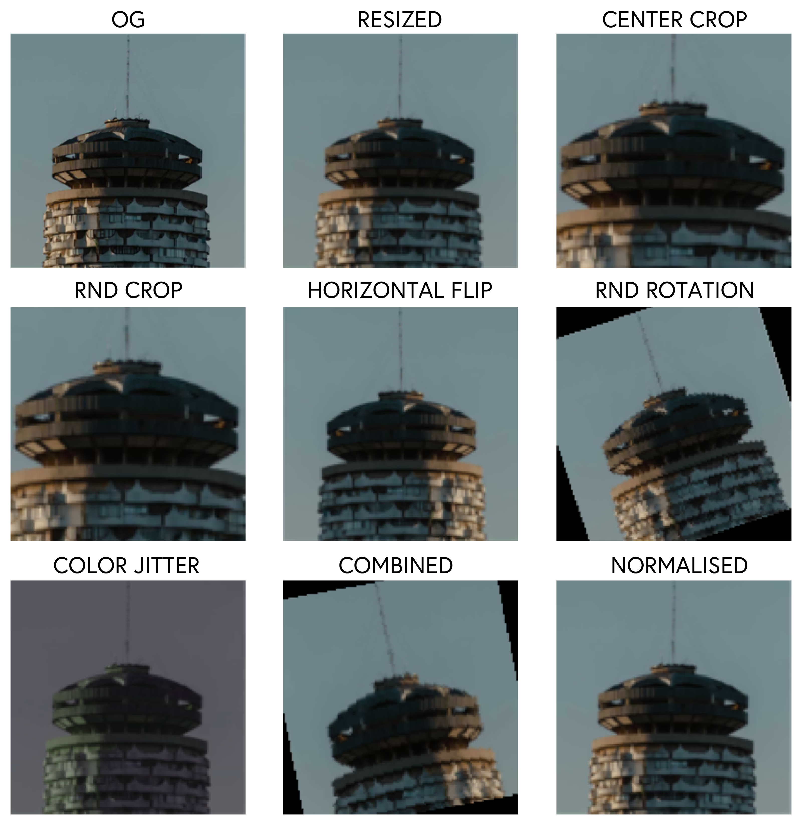
BY DR CORONA-LOPEZ
MARCH 2026
AUGMENTATIONS
artificially expanding dataset by applying transformations
benefits:
prevents overfitting
improves model generalization
handles varied real-world conditions
addresses class imbalance
09

Slide 11
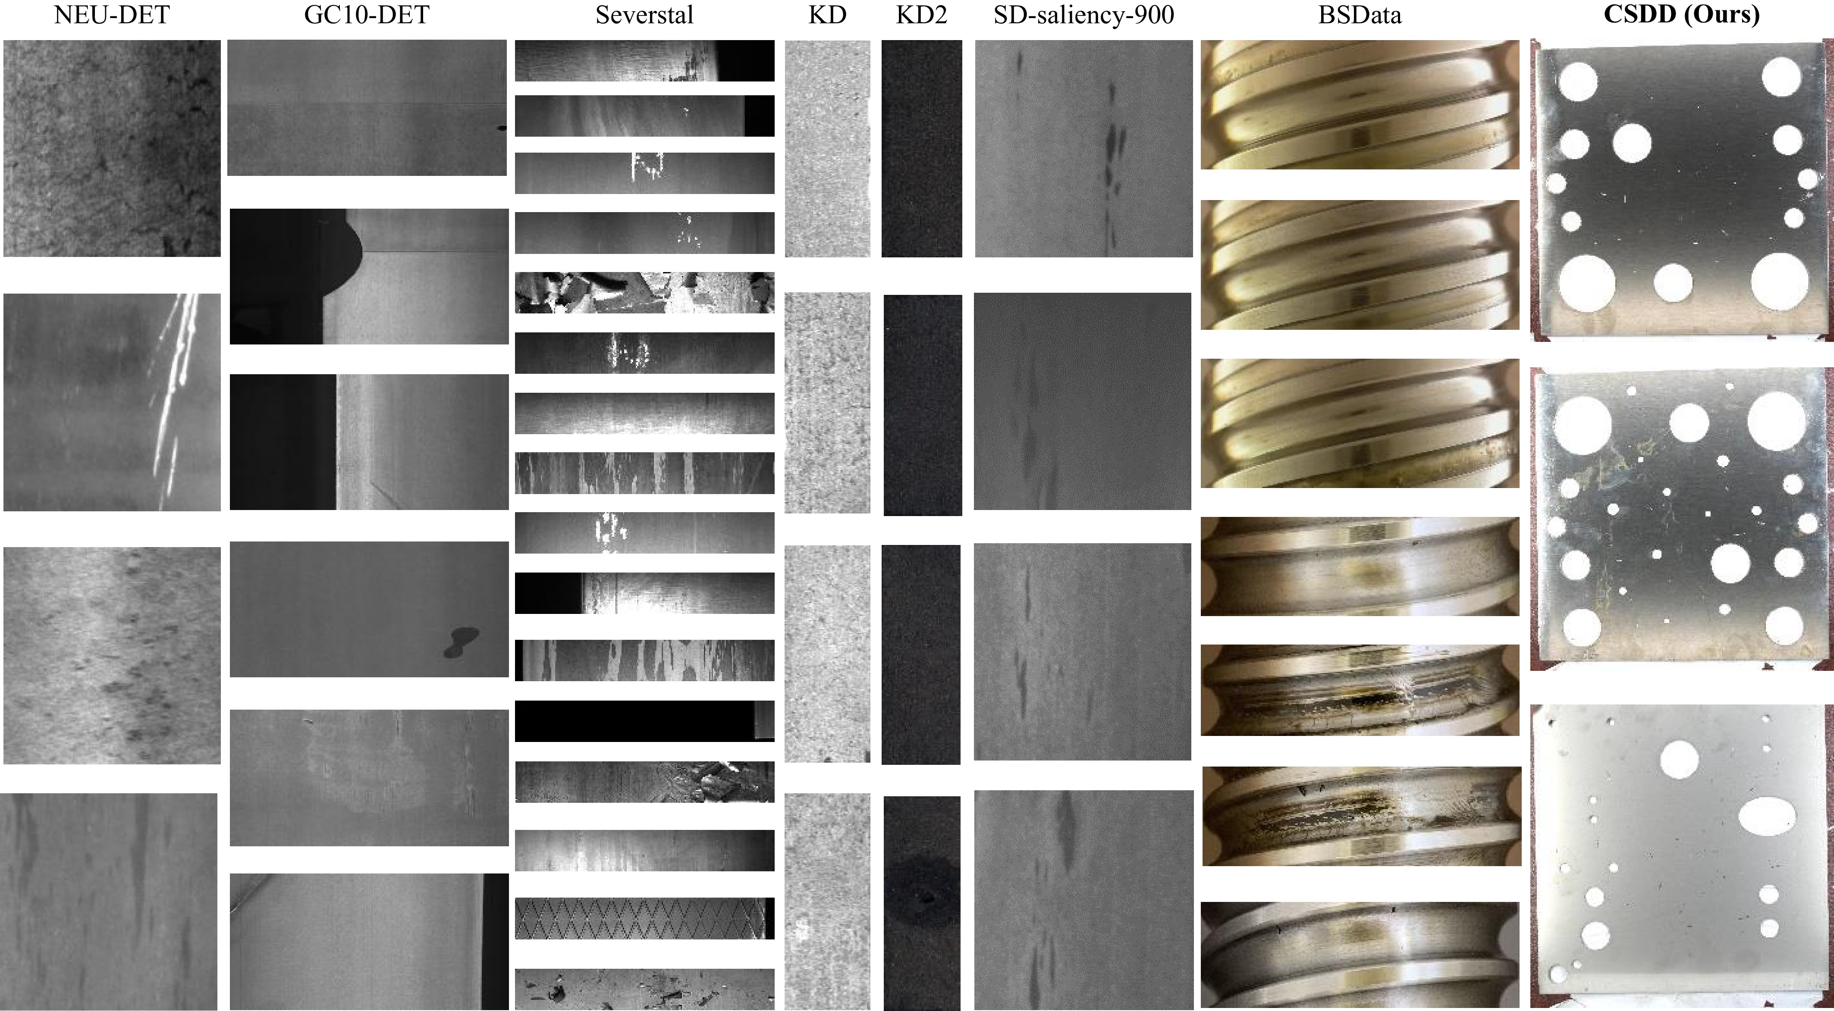
BY DR CORONA-LOPEZ
INDUSTRIAL SURFACE DEFECT DETECTION
the problem: manual quality control in manufacturing is slow, expensive, and prone to human error.
the objective: build a convolutional neural network (CNN) to automatically classify defects on hot-rolled steel strips.
dataset contents & scale:
1,800 total images (grayscale)
uniform resolution: all images are 200×200 pixels
perfectly balanced: exactly 300 images per class
the 6 defect classes: crazing (cr), inclusion (in), patches (pa), pitted surface (ps), rolled-in scale (rs), scratches (sc)
the challenge: high intra-class variation (defects of the same type look different) and low inter-class variation (different defects can look visually similar).
10

Slide 12
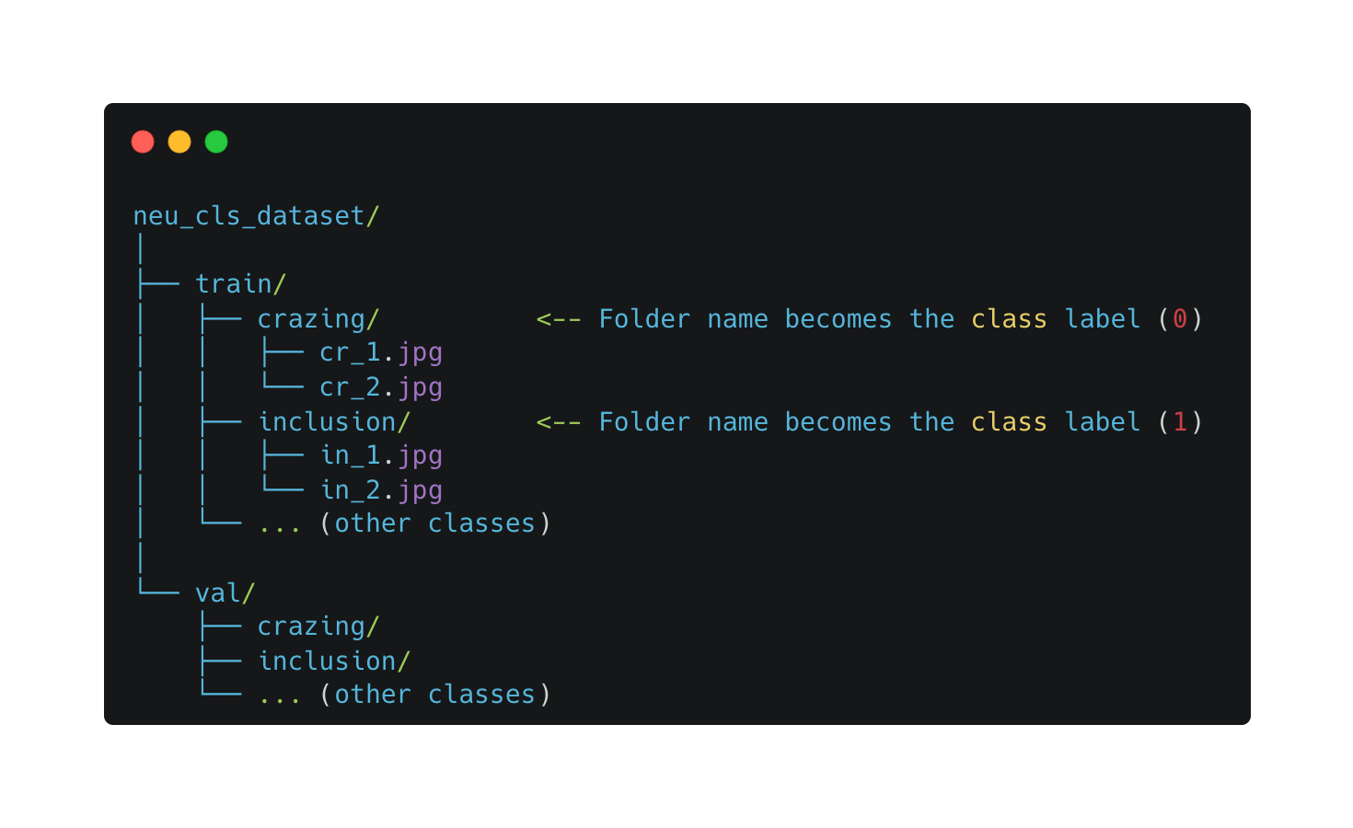
BY DR CORONA-LOPEZ
FEBRUARY 2026
DATASET ORGANISATION
a well-structured dataset allows for:
data splitting strategies
stratified splitting: ensures class distribution is maintained across splits
cross-validation: for smaller datasets or when maximum data usage is needed
11

Slide 13
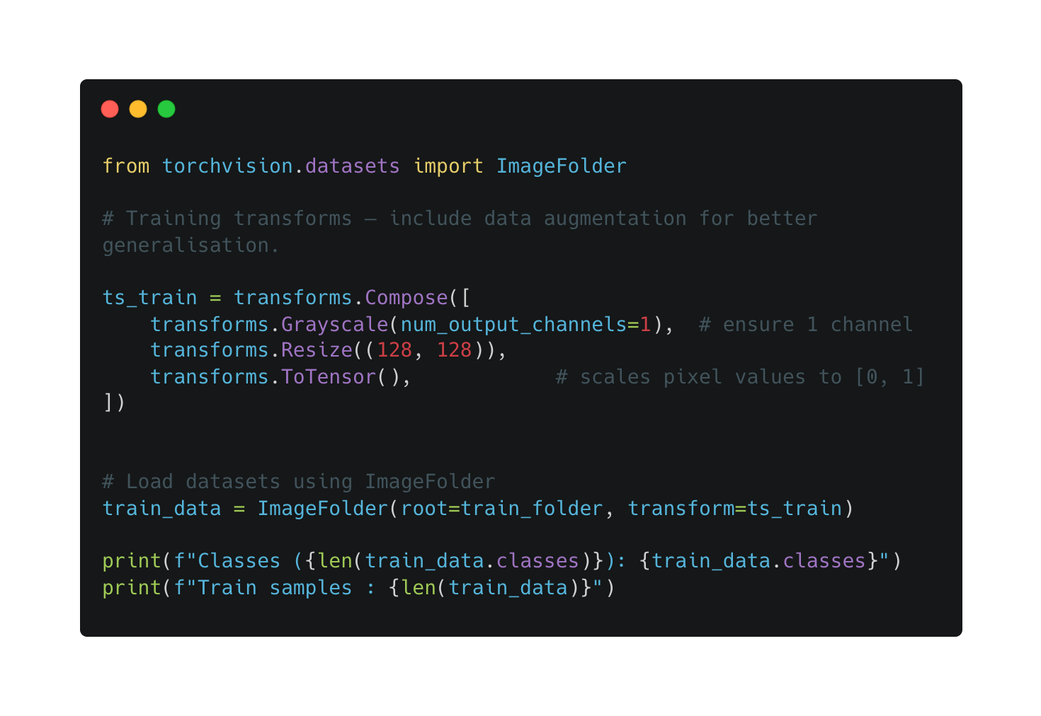
BY DR CORONA-LOPEZ
FEBRUARY 2026
DATASET ORGANISATION
12

Slide 14
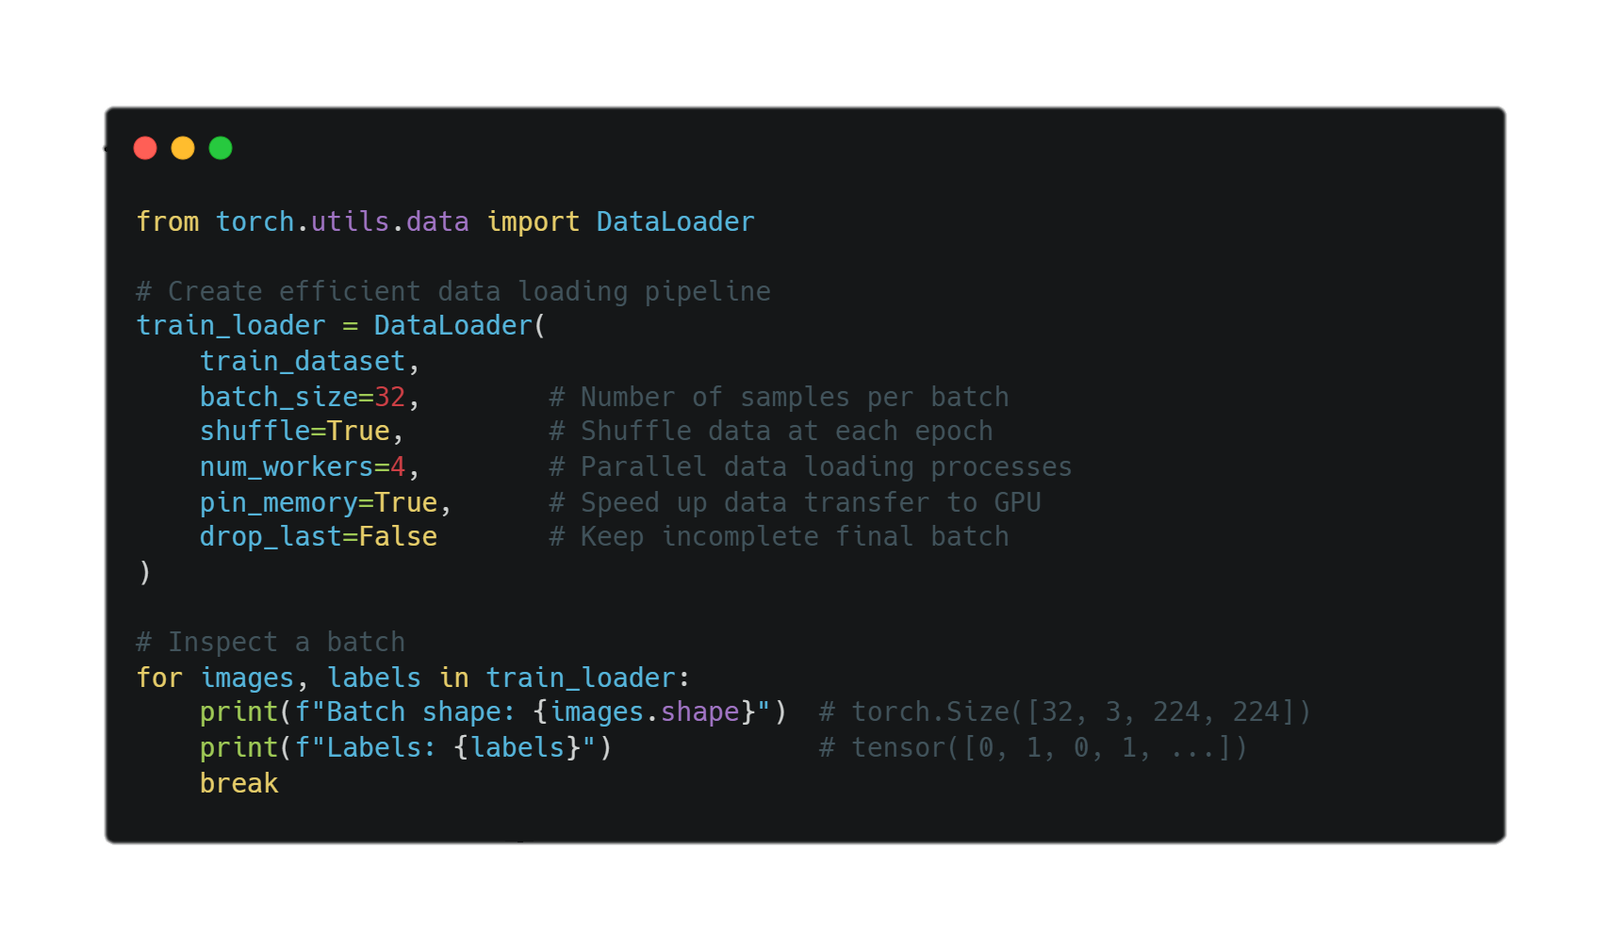
BY DR CORONA-LOPEZ
FEBRUARY 2026
DATALOADERS
we cannot load all 1,800 images into the GPU memory at once. we also need to feed the data in a randomized order so the network doesn't memorize patterns.
torch.utils.data.DataLoader wraps an iterable around your torch.utils.data.Dataset to handle all the heavy lifting automatically.
batching: groups images together (e.g., 32 at a time) to speed up training and fit into memory.
shuffling: randomizes the order of images every epoch so the model generalizes better.
multiprocessing: uses multiple cpu cores (num_workers) to load the next batch of images while the GPU is busy training the current batch.
13

Slide 15
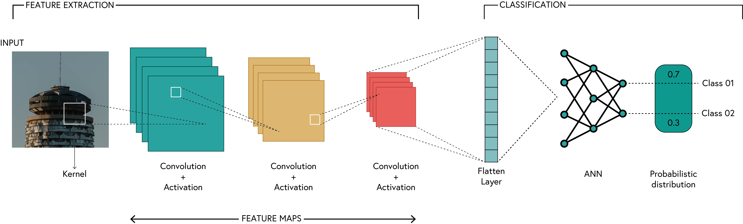
BY DR CORONA-LOPEZ
FEBRUARY 2026
CNNs
the feature extractor: we group our convolutional layers, activations (ReLu), and pooling layers into a sequence.
the classifier: after extracting features using convolutions, we use standard linear (dense) layers to make the final classification.
the flattening problem: convolutional outputs are 3d tensors (channels × height × width). linear layers expect a 1d vector.
14

Slide 16
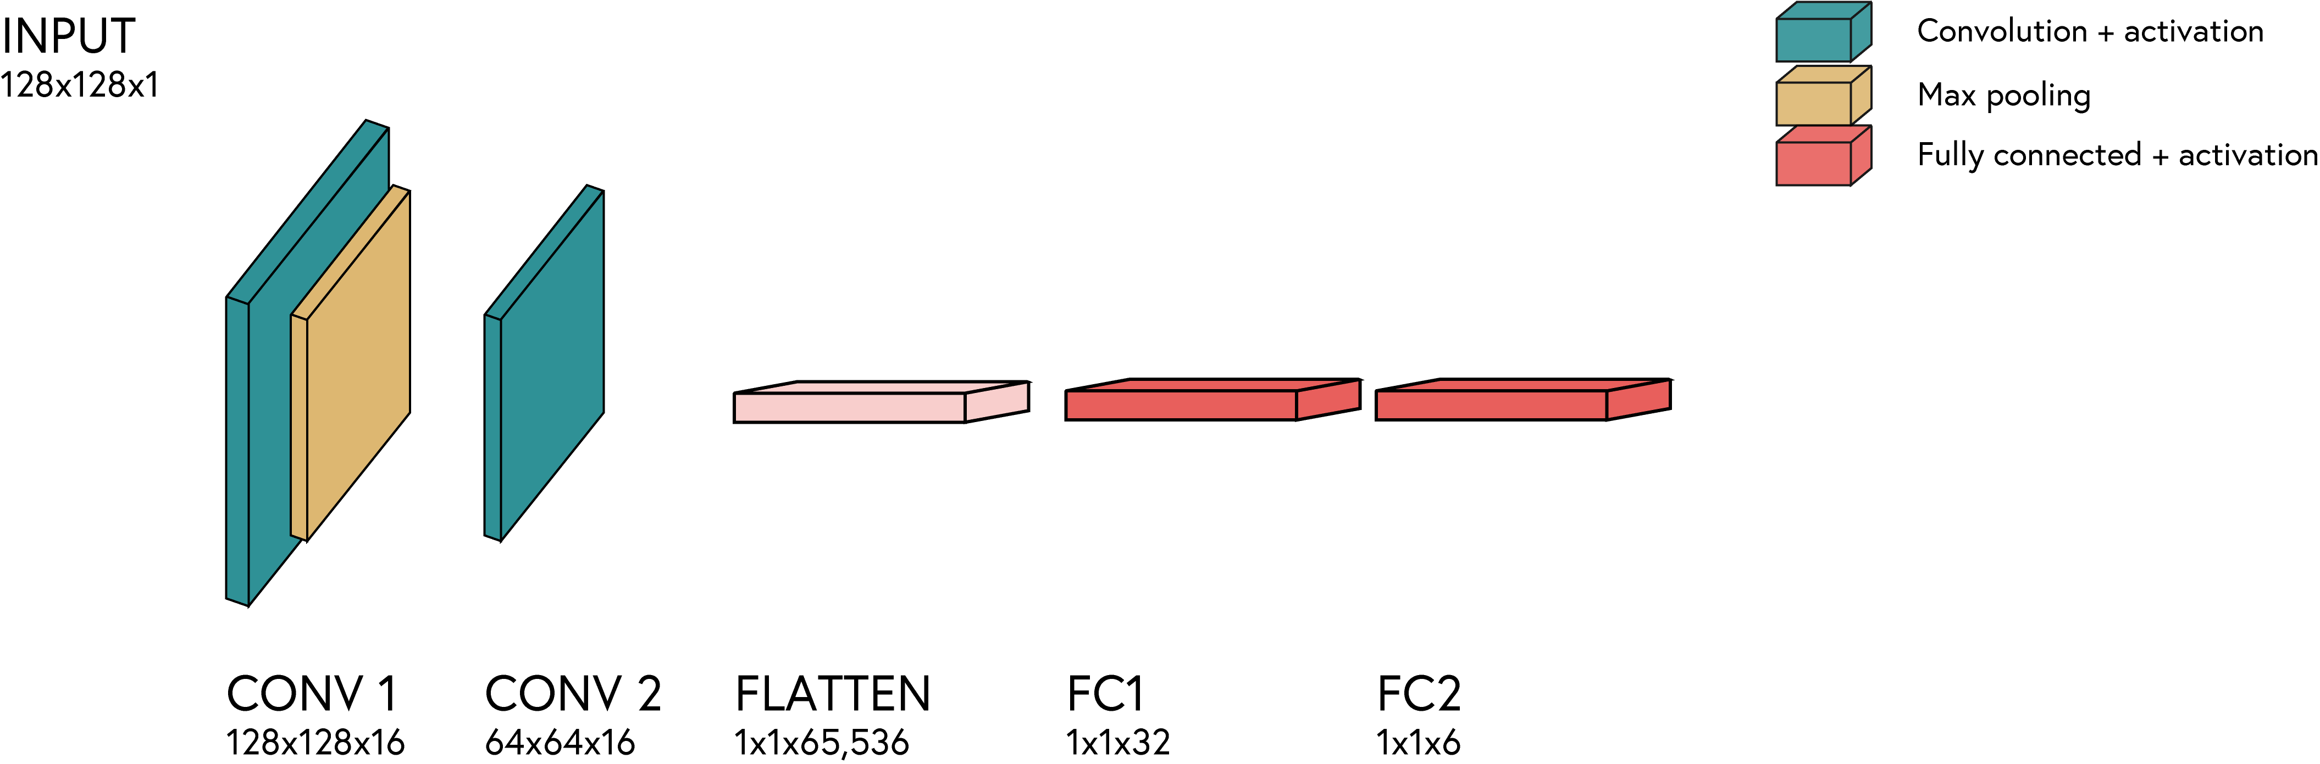
BY DR CORONA-LOPEZ
FEBRUARY 2026
CNNs
the feature extractor: we group our convolutional layers, activations (ReLu), and pooling layers into a sequence.
the classifier: after extracting features using convolutions, we use standard linear (dense) layers to make the final classification.
the flattening problem: convolutional outputs are 3d tensors (channels × height × width). linear layers expect a 1d vector.
15

Slide 17
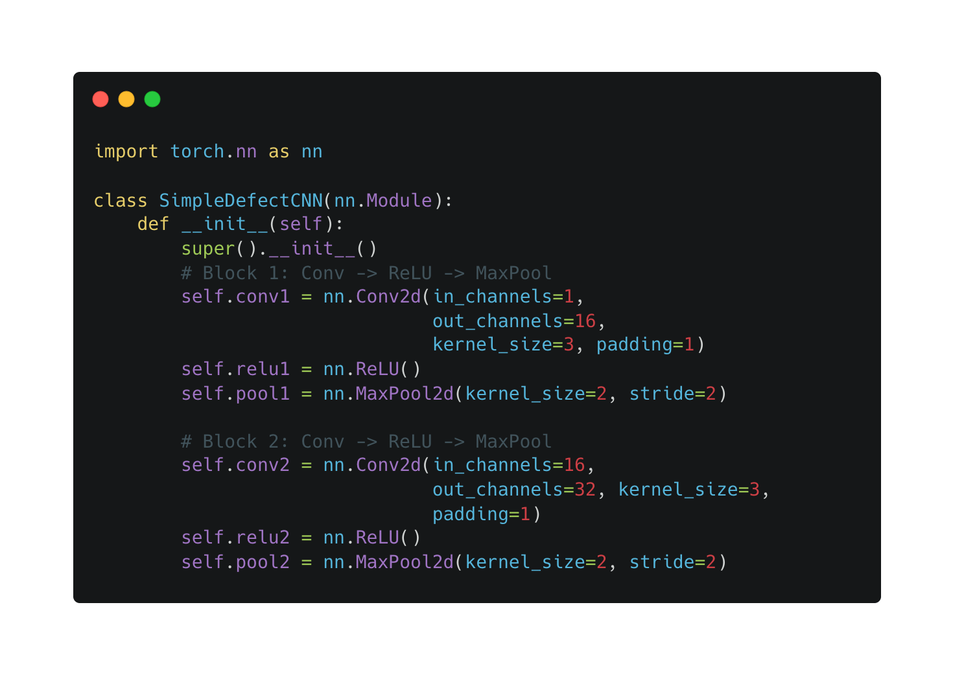
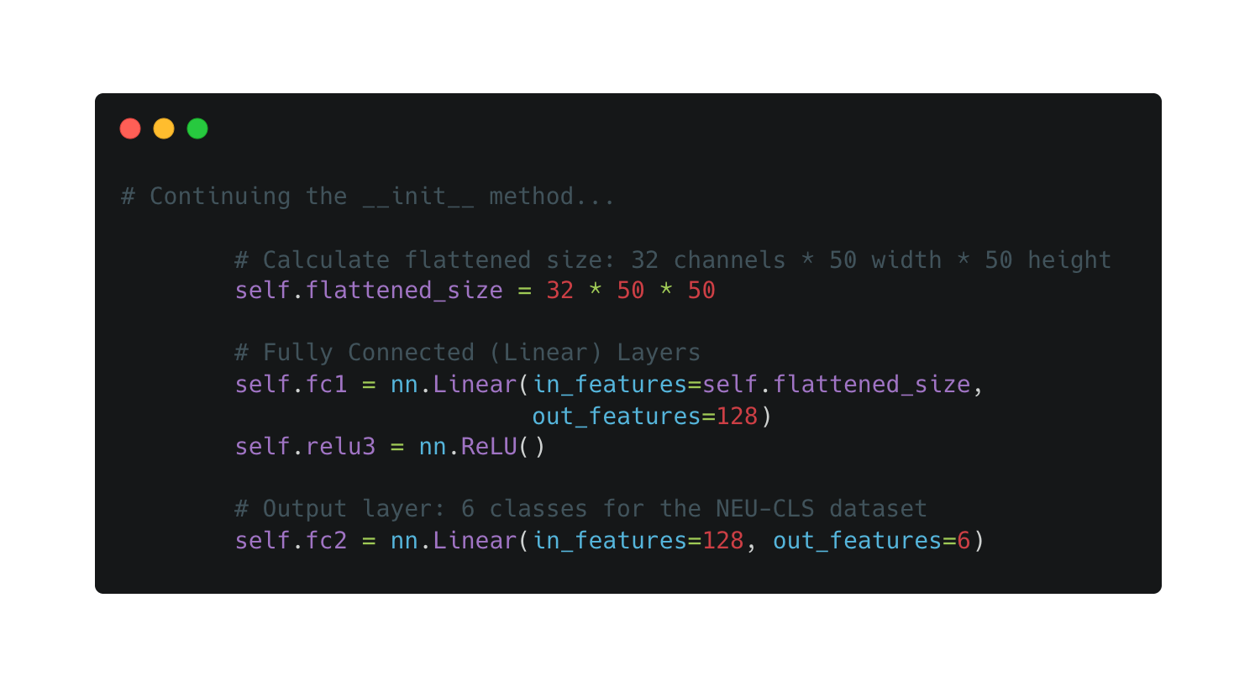
BY DR CORONA-LOPEZ
FEBRUARY 2026
CNNs
16

Slide 18
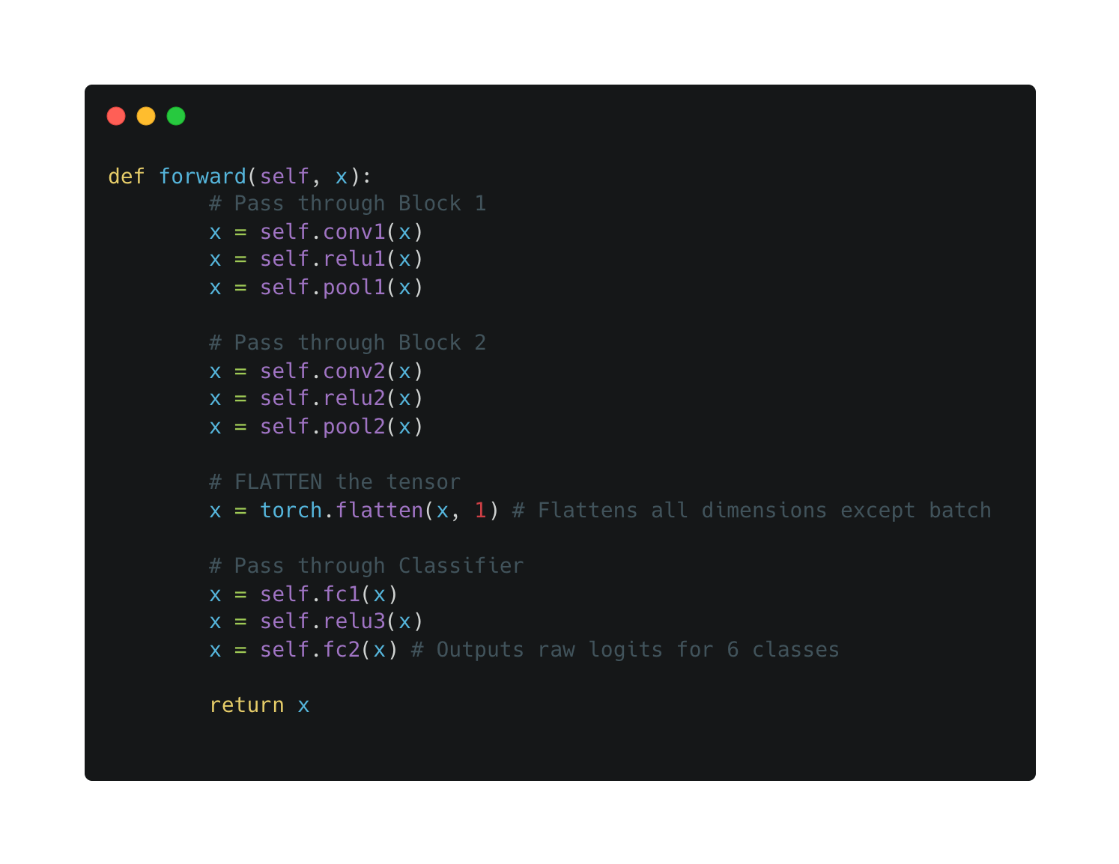
BY DR CORONA-LOPEZ
FEBRUARY 2026
CNNs
the data flow: the forward method defines the exact sequence in which the input tensor (x) passes through the layers we defined in __init__.
the flatten operation: we use torch.flatten(x, 1) or x.view() to physically reshape the tensor before passing it to the linear layers. the 1 means we flatten everything except the batch dimension.
no softmax (yet): in pytorch, we usually output raw logits (unnormalized scores) because the standard loss function (nn.crossentropyloss) applies softmax internally for numerical stability.
17

Slide 19
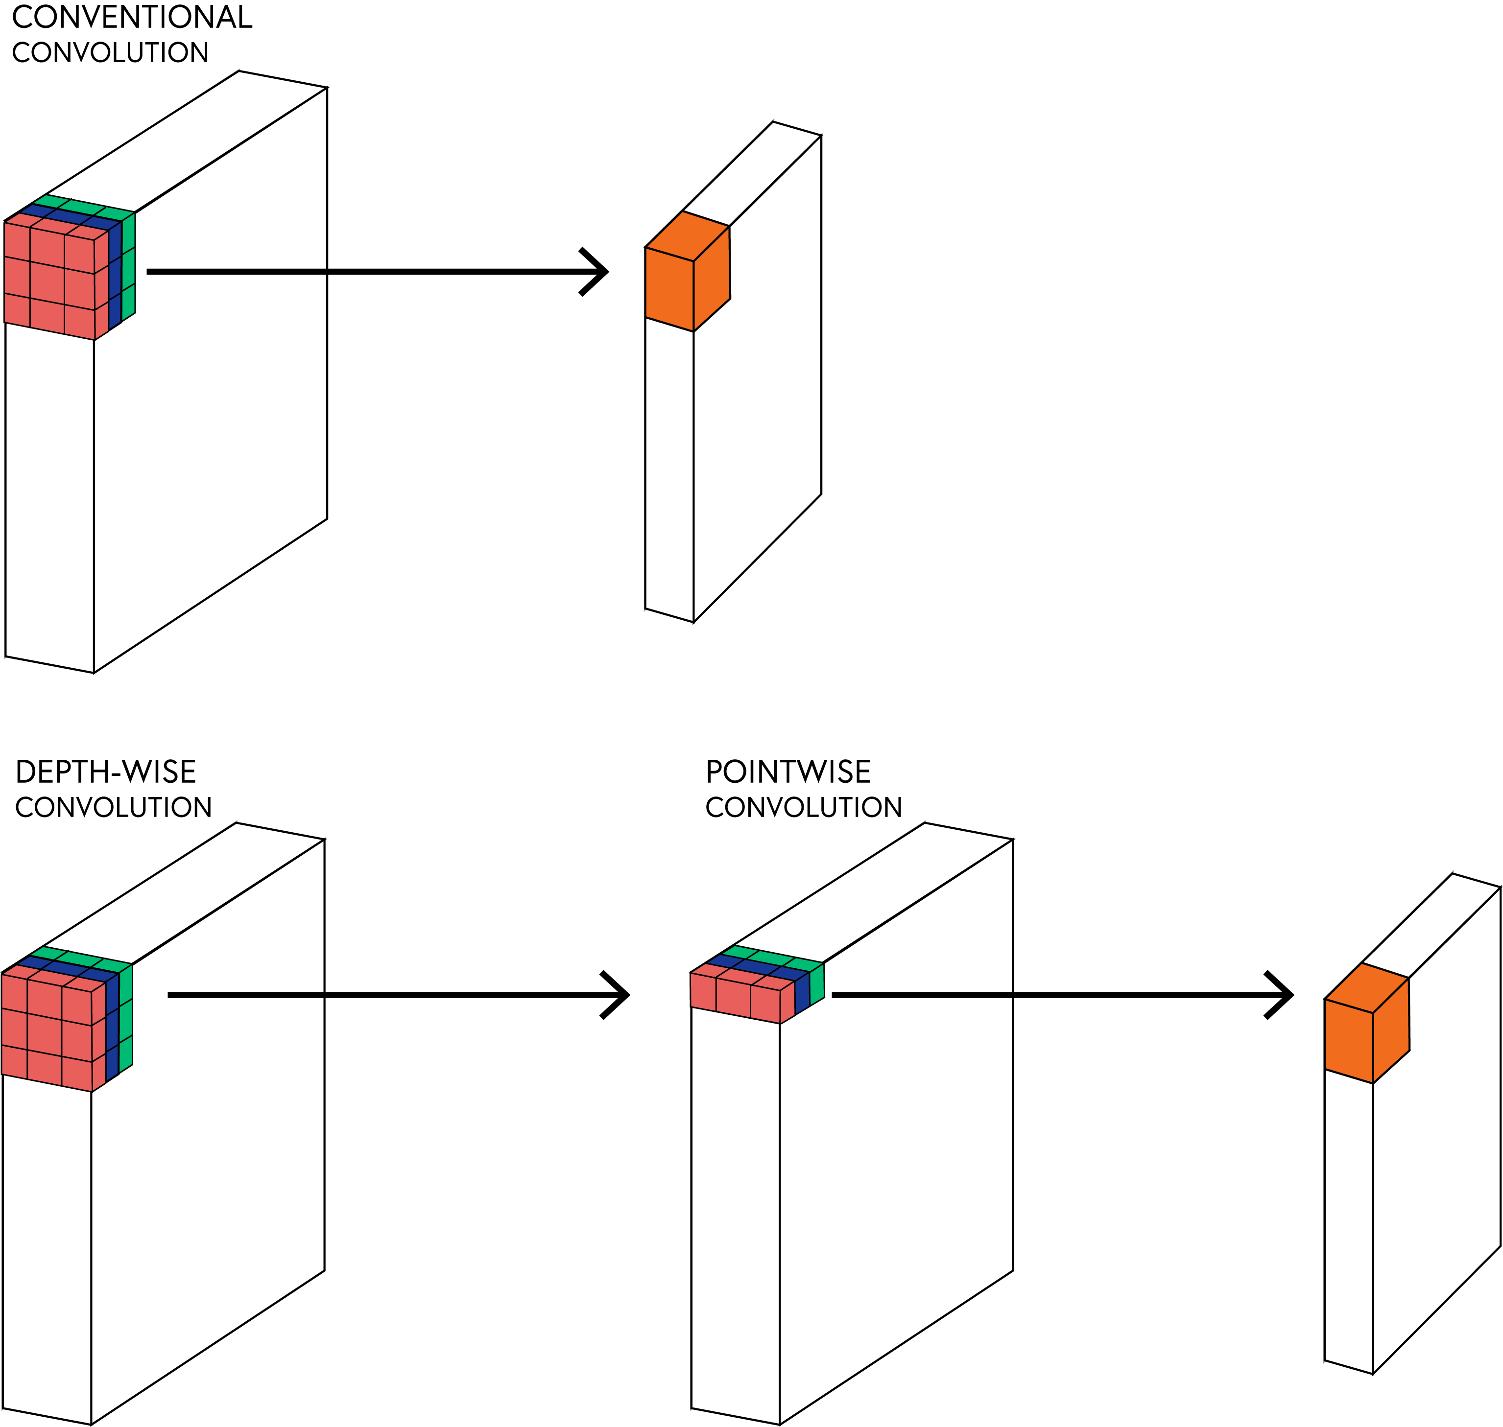
BY DR CORONA-LOPEZ
FEBRUARY 2026
BOTTLENECK
the dual task: standard convolutions do two things simultaneously:
extract spatial features (looking at neighboring pixels).
combine channels (mixing rgb or feature map channels).
the cost: because every filter interacts with every input channel across a spatial grid, the number of mathematical operations (multiply-accumulate operations) explodes as networks get deeper.
the industrial reality: in a real factory setting, computing power is often limited. we need models that can run in real-time on edge devices (like a camera over a conveyor belt) without needing a massive, expensive gpu server.
18

Slide 20
BY DR CORONA-LOPEZ
FEBRUARY 2026
DEPTHWISE CONVOLUTION
we break the standard convolution into two separate, highly efficient steps.
step 1: depthwise convolution
applies a single spatial filter to each input channel separately. it only looks at spatial patterns, not across channels.
pytorch trick: achieved by setting groups = in_channels.
step 2: pointwise convolution
a standard 1 x 1 convolution. it only looks at a single pixel but mixes the data across all channels.
19

Slide 21
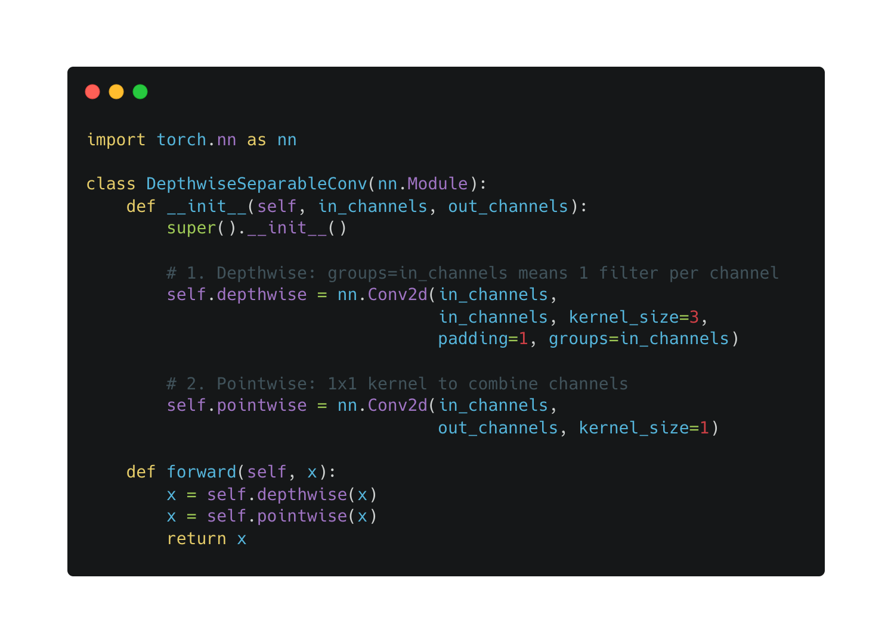
BY DR CORONA-LOPEZ
FEBRUARY 2026
DEPTHWISE CONVOLUTION
20

Slide 22
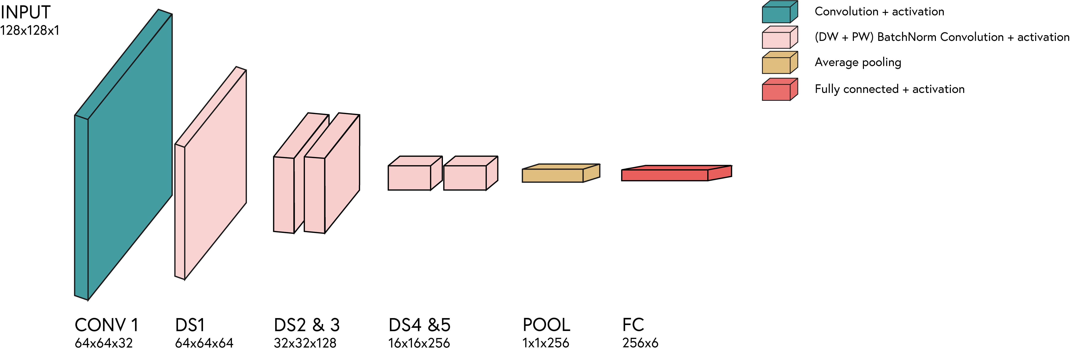
BY DR CORONA-LOPEZ
FEBRUARY 2026
MOBILENET
mobilenet is a famous architecture built almost entirely out of these depthwise separable convolution blocks.
the impact: it drastically reduces the number of parameters compared to standard architectures (like vgg or resnet). it runs significantly faster while maintaining highly competitive accuracy.
21

